Slide 1
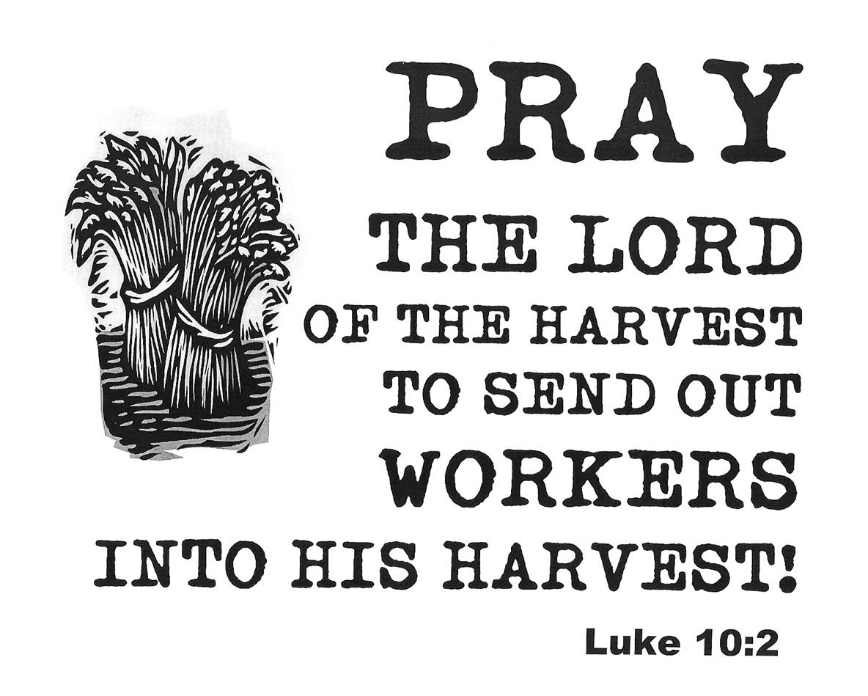
A loving Harvest

Slide 2
A loving Harvest
Blesses
with peace!
Questions: Who is it that we can never bless?
Who is it that we believe God can never grow in?

Slide 3
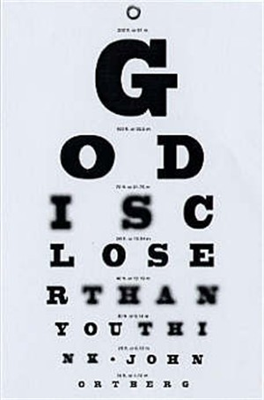
A loving Harvest
2. Shares Love!
Questions:
Who is it that needs our strength and presence?
Who is it that asks questions about Jesus?

Slide 4
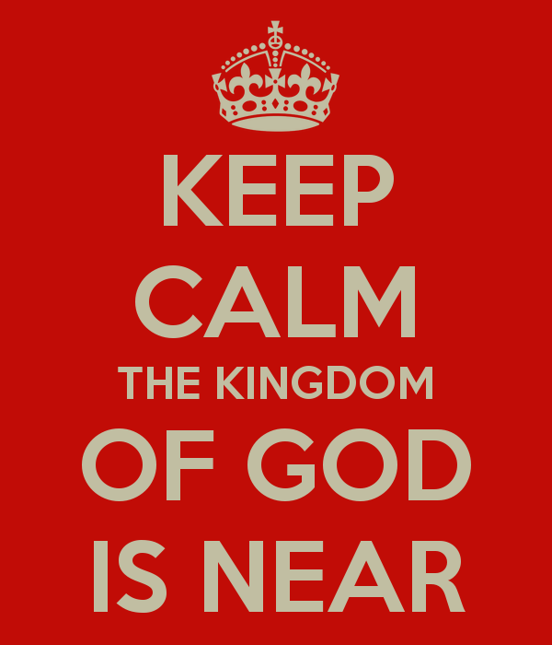
A loving Harvest
3. Draws the
kingdom of God near
Questions:
Who is it that God has been transforming?
What more do you need to transform in your life to love and live the kingdom more?

Slide 5
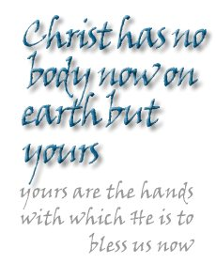
A loving Harvest

