Slide 1
Where are we going?

Slide 2
Divine Paternity/Divine Majesty
Our Father in Heaven (Matt. 6:9).
-Loving paternity.
-Infinite majesty.
The prophet Isaiah says he is ‘the high and lofty one who inhabits eternity, whose name is holy’.(Is.57:15)

Slide 3
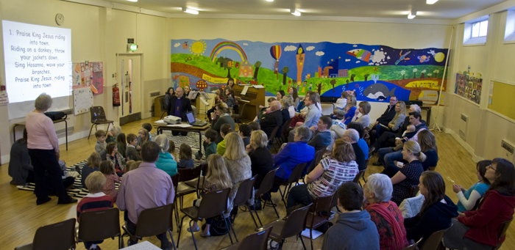
Divine Community 1
The Church is described in the Bible as the family of God.

Slide 4
Divine Community 2
Paul teaches in:
Galatians 6:10, ‘Let us do good to all people, especially to those who belong to the family of believers’ and in
1 Timothy 3:15 he says ‘you will know how people ought to conduct themselves in God’s household, which is the church of the living God, the pillar and foundation of the truth’.

Slide 5
God’s Kingdom
Your Kingdom come (Matt.6:10).
- Expresses the hope of God’s people throughout all of history.
-The Psalmist says, ‘the Lord has established His throne in the heavens and His Kingdom rules over all’ Ps. 103:19)
-Paul explained to Colossian Christians that God the Father - ‘has rescued us from the power of darkness delivered us from the dominion of darkness and transferred us into the kingdom of his beloved Son, in whom we have redemption, the forgiveness of sins’ (Colossians 1:13).

Slide 6
Eternal Life (aionios)
-Eternal life - not merely length (quantity), but also depth (quality).
-Source - God’s Son, Jesus.
‘And this is the testimony: God has given us eternal life, and this life is in his Son. He or She who has the Son has life: he or she who does not have the Son of God does not have life’ (1 John 5: 11-12).
Stott says, ‘But since the age to come has broken into this present age, the life of the age to come, namely ‘eternal life’ can be received and enjoyed here and now’.

Slide 7
Joy, Challenge and Sadness
‘Encouraging a love for scripture here in Northern Ireland is becoming an enormous challenge. This Autumn I hope to spend some time with groups of clergy, to see what we can do to enable more people to open this special book for themselves’. (Bible Society NI Autumn 2013 Magazine)

Slide 8
The Promised Kingdom of Glory
-God’s kingdom of grace has both a present and a promised aspect to it.
-Those who believe in Jesus now will dwell in his eternal kingdom of glory one day.
-Our fellowship with God will be greater than anything we have ever known in this scene of time.

Slide 9
The Book of Revelation
- Two pictures.
- Rev. 5:6 - Lamb (Jesus) in the centre of a throne.
- Rev. 7:9-10 - the Bride, the wife of the Lamb - the Christian Church.
John says, ‘I looked and there before me was a great multitude that no-one could count, from every nation, tribe, people and language, standing before the throne and in front of the Lamb. They were wearing white robes and were holding palm branches in their hands. And they cried out in a loud voice: Salvation belongs to our God, who sits on the throne, and to the Lamb’.

Slide 10
Where are we going?
The story has more than a happy ending. We can look forward to the day when we shall be all together with God.
We live in the day of grace and we must live in a way that is worthy of our place in front of the lamb.

