Slide 2
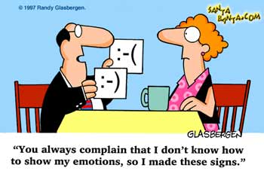

Slide 4
Progress ➔
 economics
 consumer choice
 leisure time
 info., science, technology
 lifespan

Slide 5
Progress ➔
 Infinite Choices/Decisions
 Expectation of Performance
 Saturation of Technology
 Velocity of Change
 Instability of Relationships

Slide 7
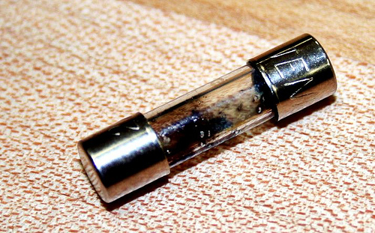

Slide 8
Overloading emotions = “overdosing on our own adrenaline”
—Richard Swenson, M.D.

Slide 9
 premature ageing
 fatigue; insomnia
 muscle tension/pain
 migraines
 cancer
 gastrointestinal overactivity
 cardiovascular catastrophes

Slide 10
 focused on personal needs
 anger, violence
 psychiatric disorders
 social isolation
 BEEPS

Slide 12
“your relationship with God will be limited. Not only will you be unable to share your feelings with him, but you’ll be functionally disconnected from his feelings.”
—Dr. Ed Smith

Slide 13
“ ‘my unfailing love for you will not be shaken,
nor my covenant of peace be removed,’
says Yahweh, who has compassion on you.”
—Isaiah 54.10

Slide 14
“Emotions are indicators of what we experientially believe. . . . we feel whatever we believe. God has designed us to feel whatever we hold as truth. . . .”
—Dr. Ed Smith

Slide 15
“. . . streams of living water will flow from within him . . .”
—Jesus in John 7.37–39
koilia = gut

Slide 17
“. . . pray about everything. Tell God what you need, and thank him for all he has done. Then you will experience God’s peace . . .”
—Paul to the Philippians 4.4–7

Slide 19
“I have always been mindful of your unfailing love,
and have lived in reliance on your faithfulness.”
—David to God,
Psalm 26.2–3

