Slide 1
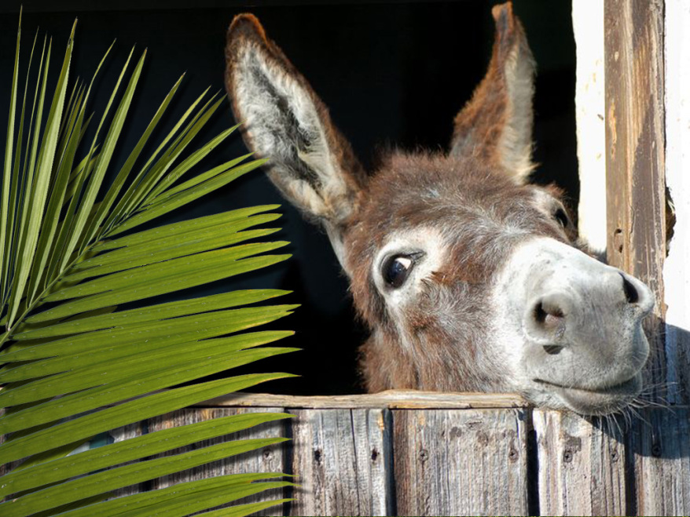
Palm Sunday

Slide 2
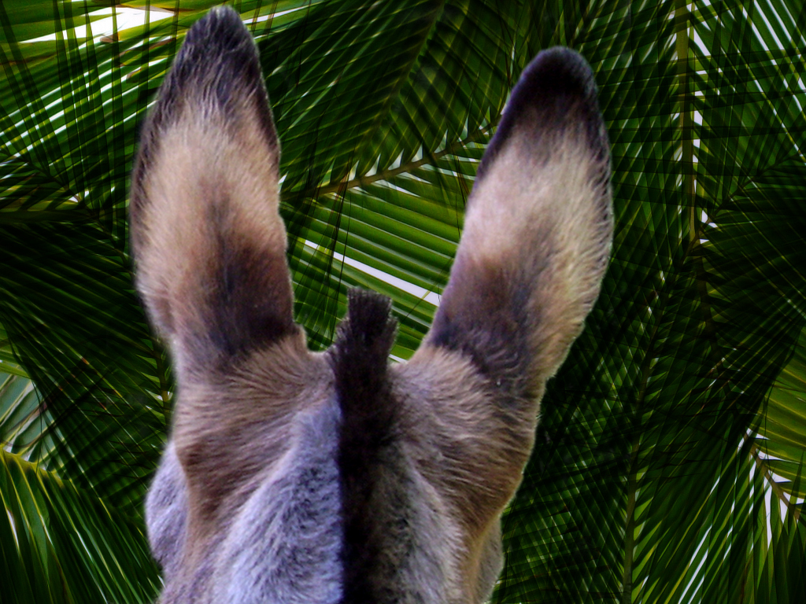
Why did Jesus ride into Jerusalem on a donkey?

Slide 3
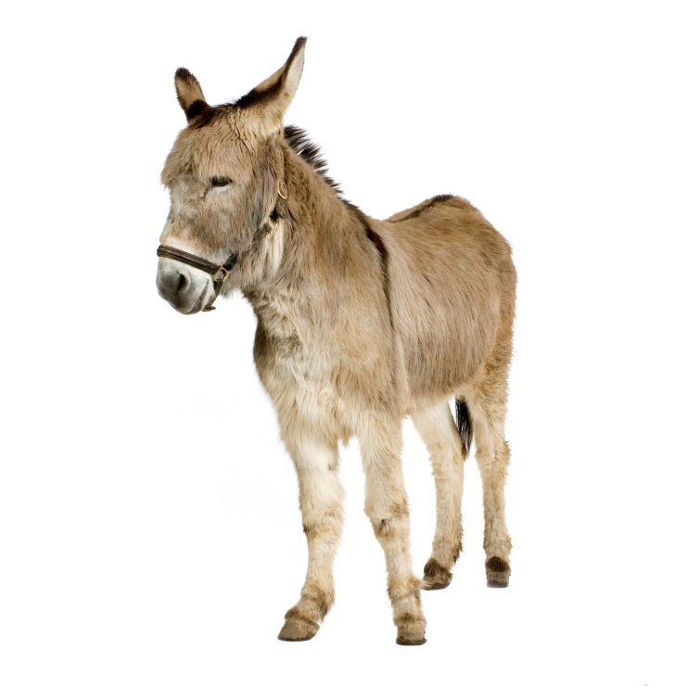
To fulfil a prophesy
Zechariah 9v9
Rejoice, O people of Zion! Shout in triumph, O people of Jerusalem! Look, your king is coming to you. He is righteous and victorious, yet he is humble, riding on a donkey—riding on a donkey’s colt.

Slide 4
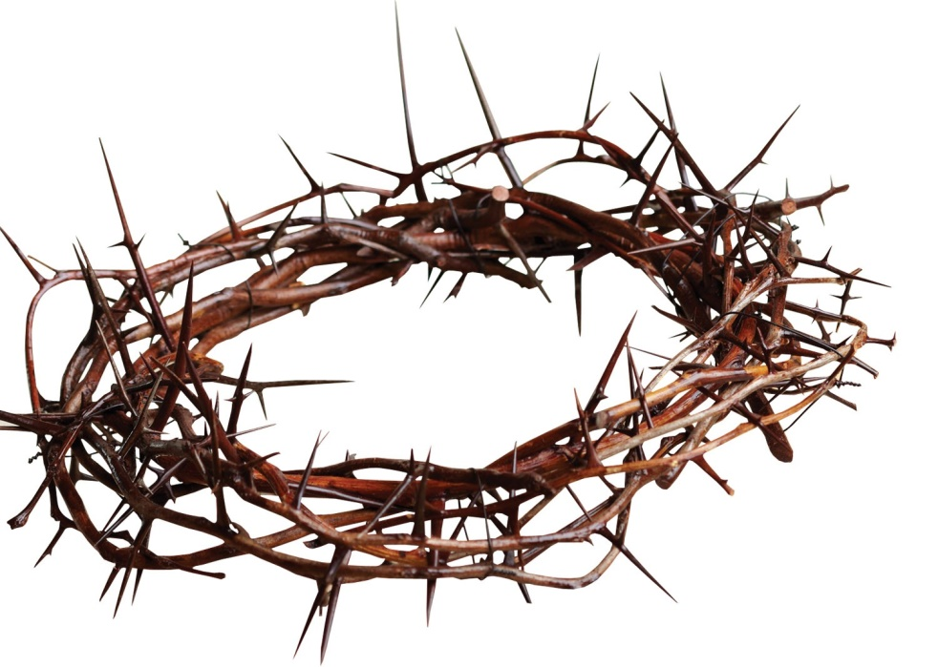
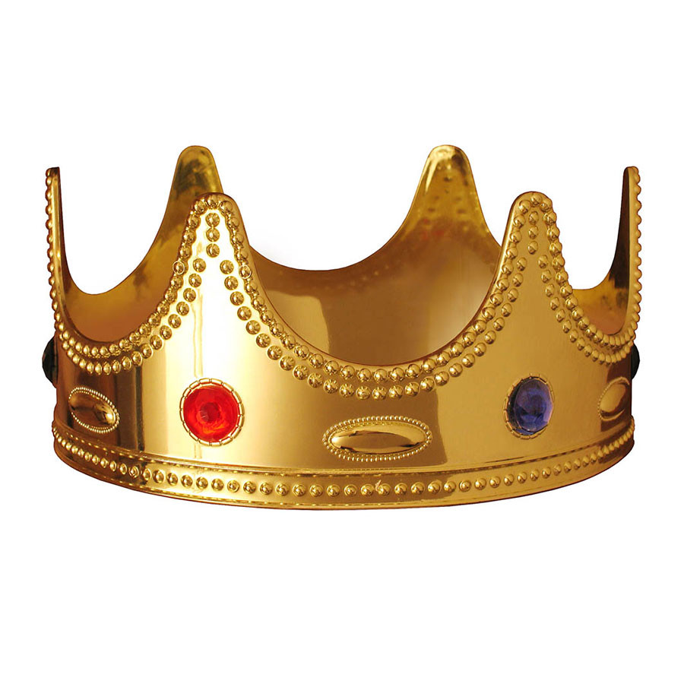
To present himself as Israel’s King

Slide 5
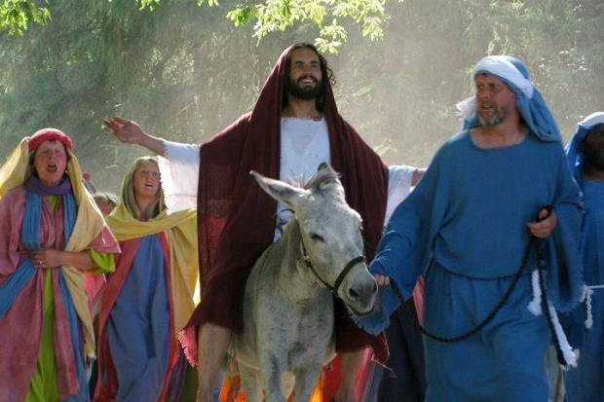

Slide 6
To force the religious leaders to act
Matthew 26 v 3-5
³ At that same time the leading priests and elders were meeting at the residence of Caiaphas, the high priest, ⁴ plotting how to capture Jesus secretly and kill him. ⁵ “But not during the Passover celebration,” they agreed, “or the people may riot.”

Slide 7
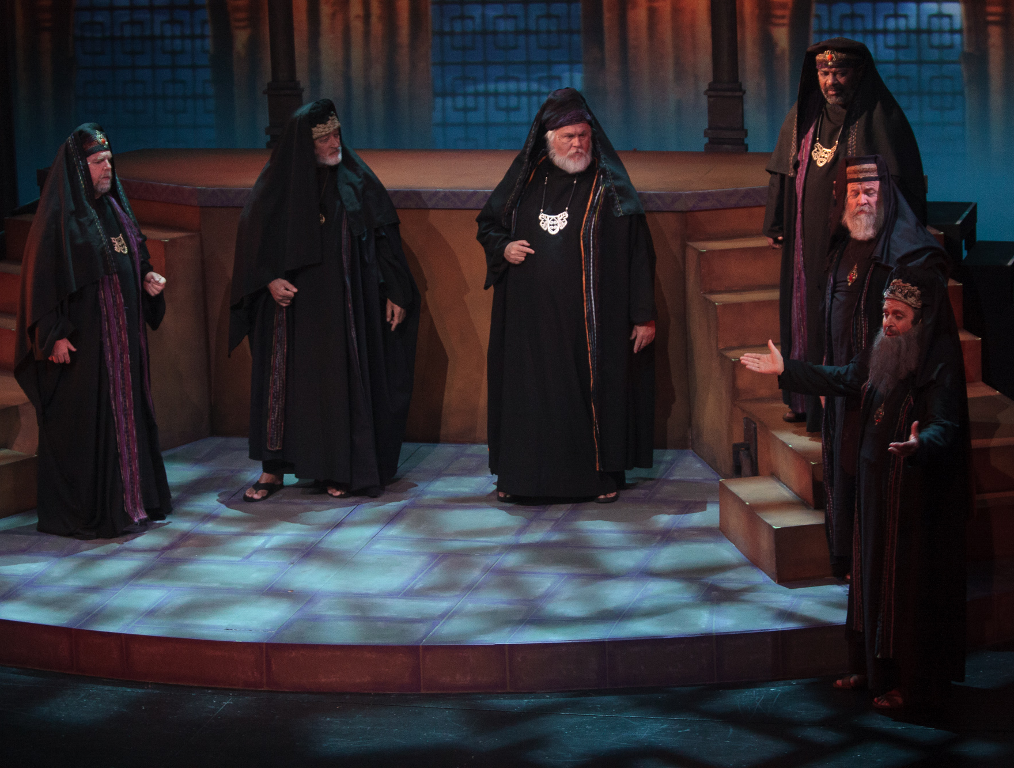
Plotting against Jesus

Slide 8
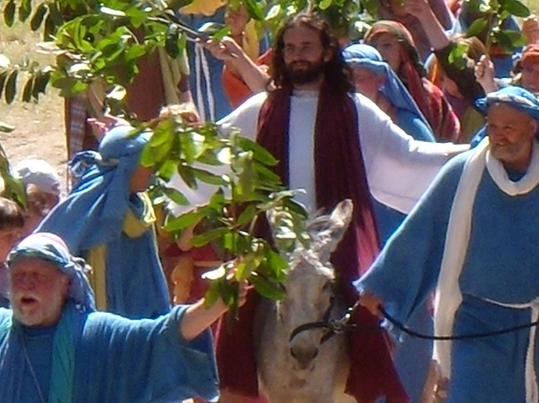

Slide 9
It was the right time
Exodus 12 v 3,6
³ Announce to the whole community of Israel that on the tenth day of this month each family must choose a lamb or a young goat for a sacrifice, one animal for each household.
⁶“Take special care of this chosen animal until the evening of the fourteenth day of this first month. Then the whole assembly of the community of Israel must slaughter their lamb or young goat at twilight.

Slide 10
