Slide 16
32,458

Slide 20
85% would like to get married

Slide 21
10 years ago 46% intend to live with someone before marriage 78% last year

Slide 22
13% are sexually active

Slide 23
25% waiting for marriage 30% don’t know

Slide 24
29% of males access pornography daily, 27% weekly

Slide 30
How would a Jesus looking church respond?

Slide 31
David and Goliath 1 Samuel 17

Slide 32
“Who is this Philistine that he should defy the armies of the living God?”
“The Lord who delivered me from the paw of the lion and the paw of the bear, He will deliver me from the hand of this Philistine”
“You come against me with sword and spear and javelin, but I come against you in the name of the Lord Almighty, the God of the armies of Israel, whom you have defied. This day the Lord will haven you over to me, and I’ll strike you down and cut of your head….”

Slide 33
FOCUS

Slide 34
“Who is this Philistine that he should defy the armies of the living God?”
“The Lord who delivered me from the paw of the lion and the paw of the bear, He will deliver me from the hand of this Philistine”
“You come against me with sword and spear and javelin, but I come against you in the name of the Lord Almighty, the God of the armies of Israel, whom you have defied. This day the Lord will haven you over to me, and I’ll strike you down and cut of your head….”
“he runs towards the army to meet the Philistine”

Slide 35
FOCUS

Slide 36
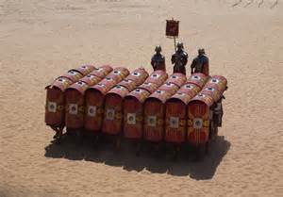
FOCUS
TOGETHER

Slide 37
Never doubt that a small group of thoughtful, committed people can change the world. Indeed, it is the only thing that ever has.
Margaret Mead

Slide 38
FOCUS
TOGETHER

Slide 39
FOCUS
TOGETHER
10p mix up CHALLENGE

Slide 40
PRIORITY
PASSION
PRAYER
PERSISTENCE
PAST

Slide 41
PROTECT
PARENT
PROACTIVE
PREPARED
POSITIVE

Slide 42
FOCUS

Slide 43
FOCUS
TOGETHER

Slide 44
FOCUS
TOGETHER
10p mix up CHALLENGE

