Slide 1
Think of something
that is so precious to you…
Something irreplaceable or priceless.

Slide 2
Would you give it to
a friend to look after for you?

Slide 3
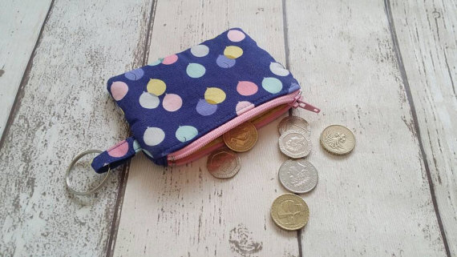

Slide 4
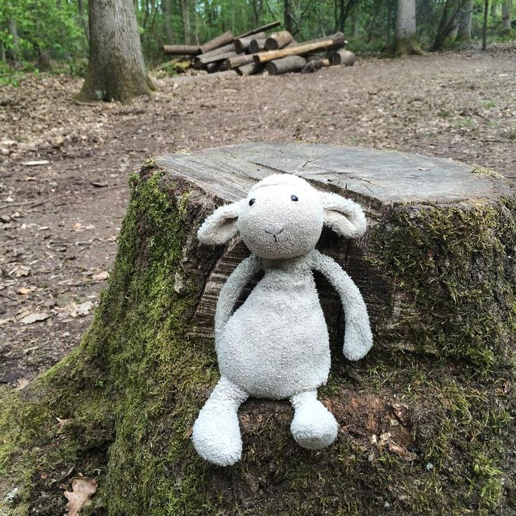

Slide 6
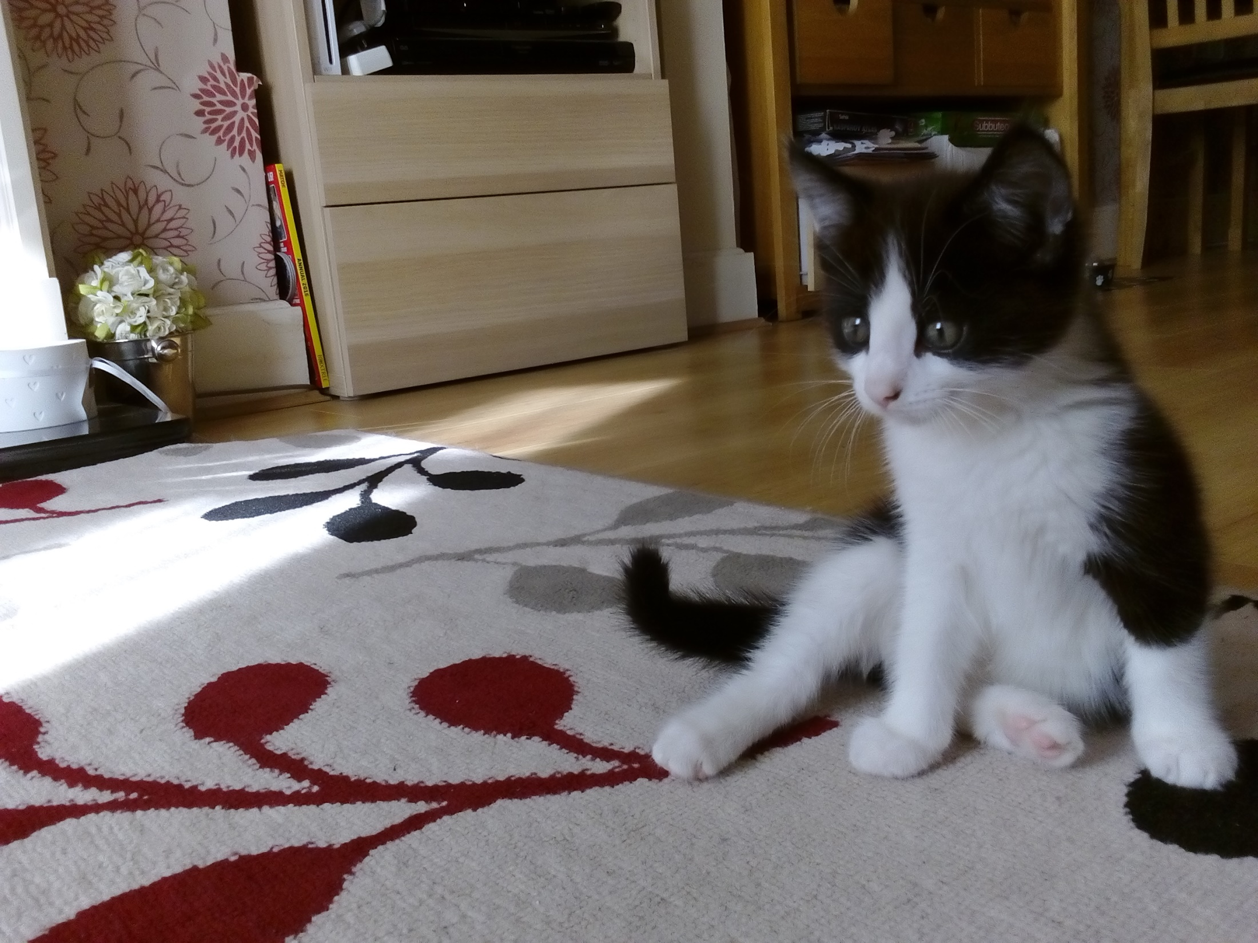

Slide 7
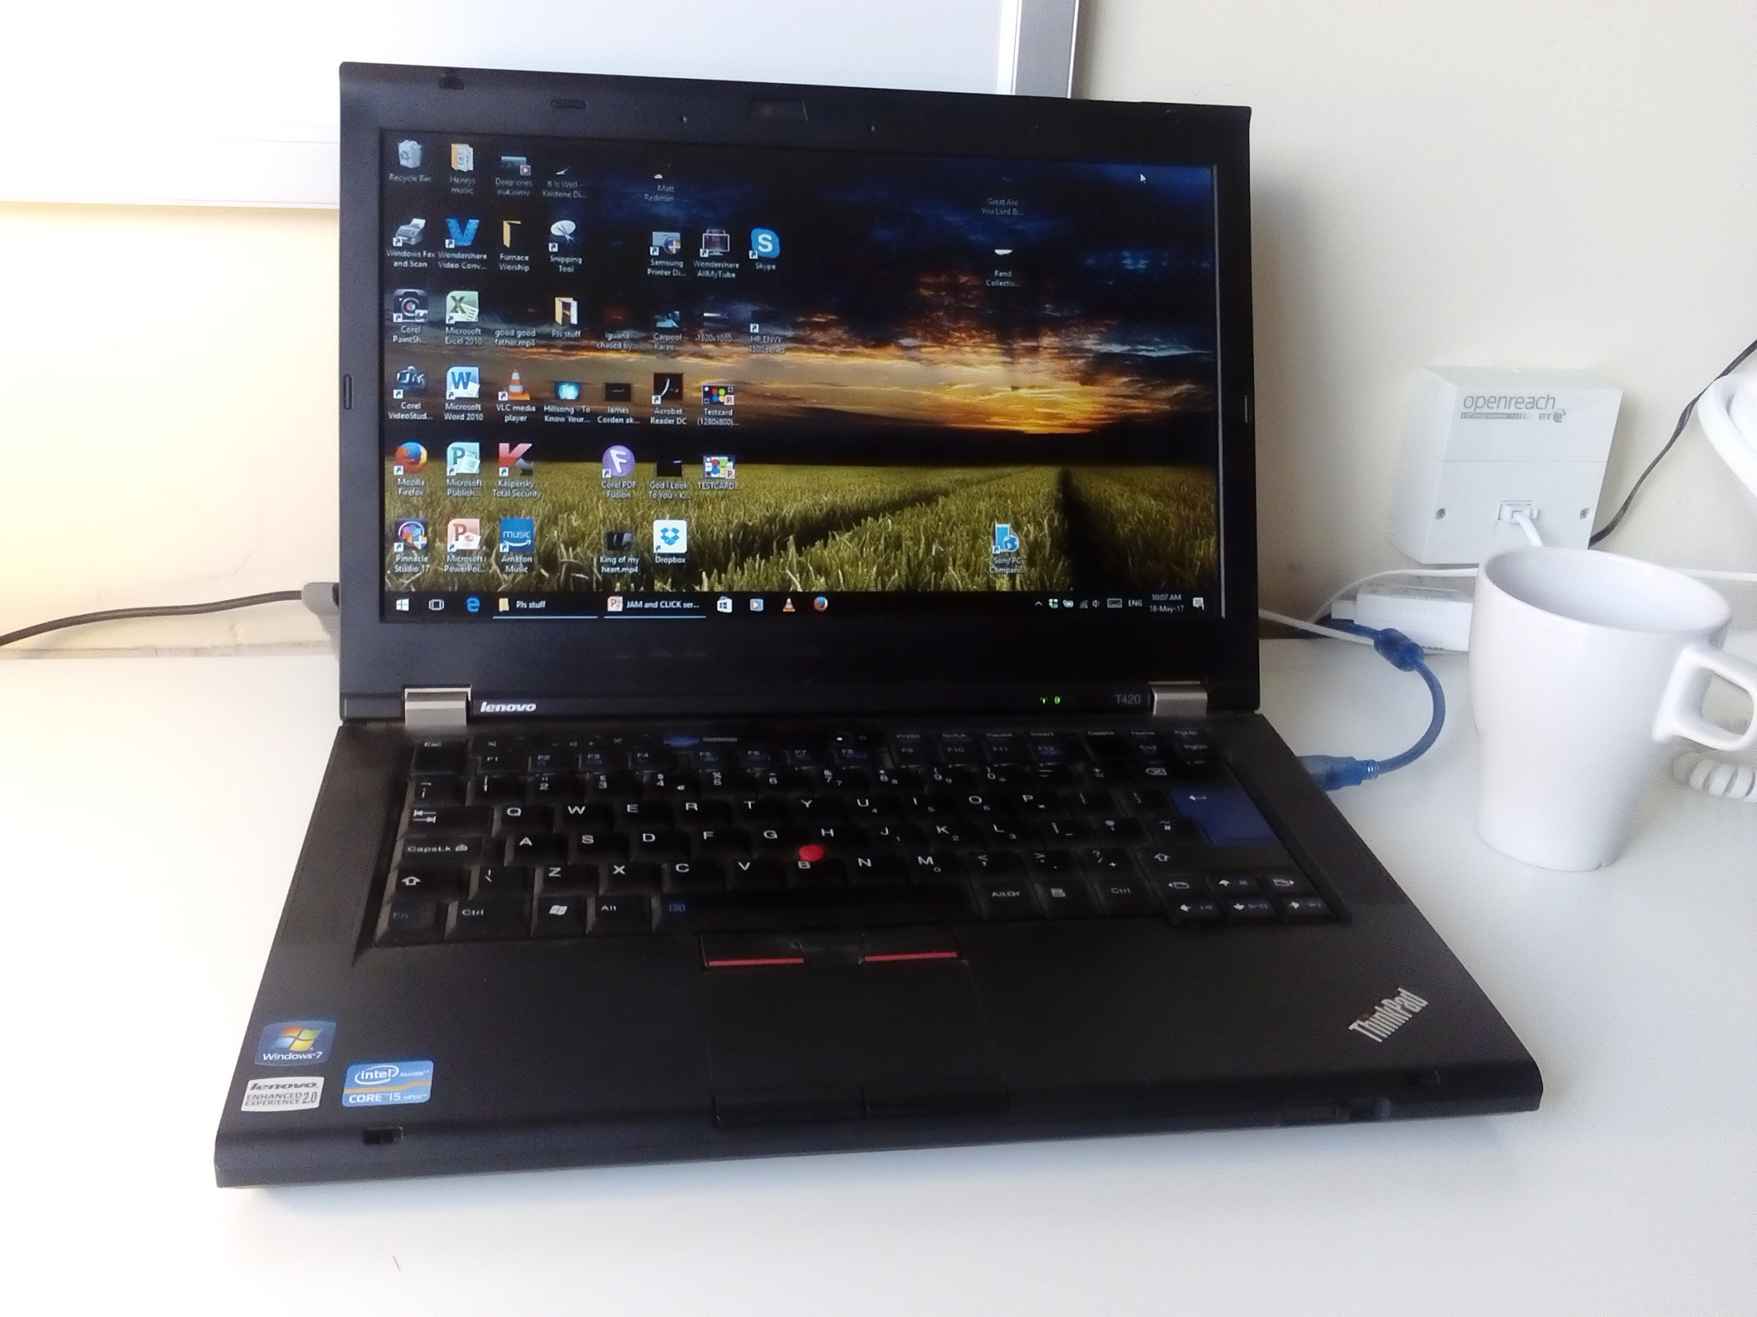

Slide 8
When we think of making
disciples of Jesus Christ,
who do we look to
to do that job?

Slide 9
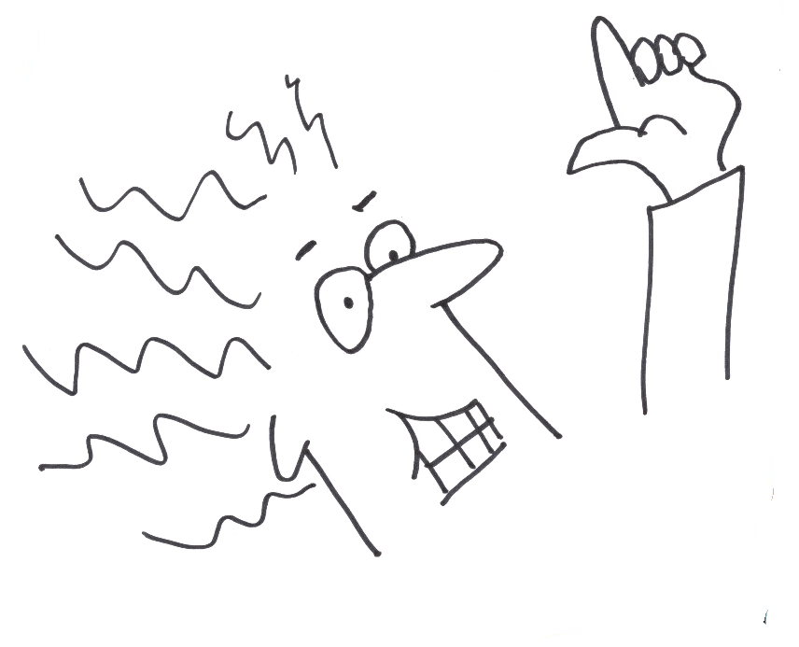

Slide 10
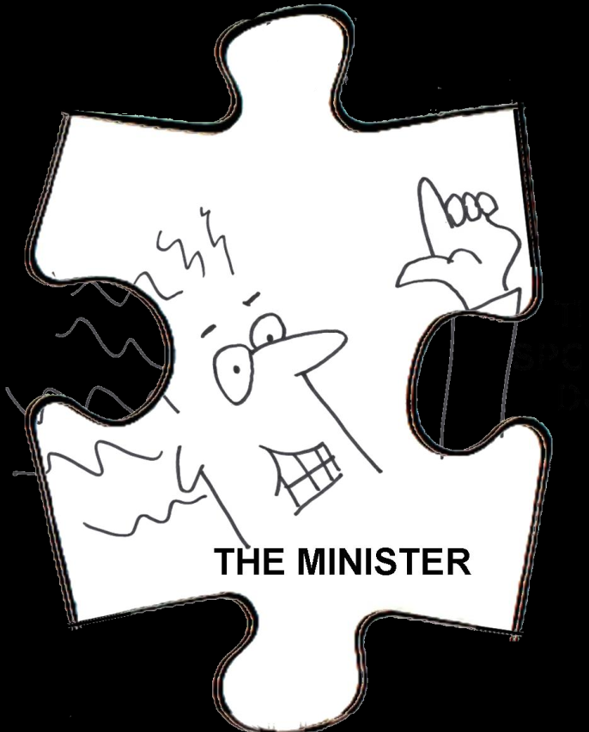

Slide 18
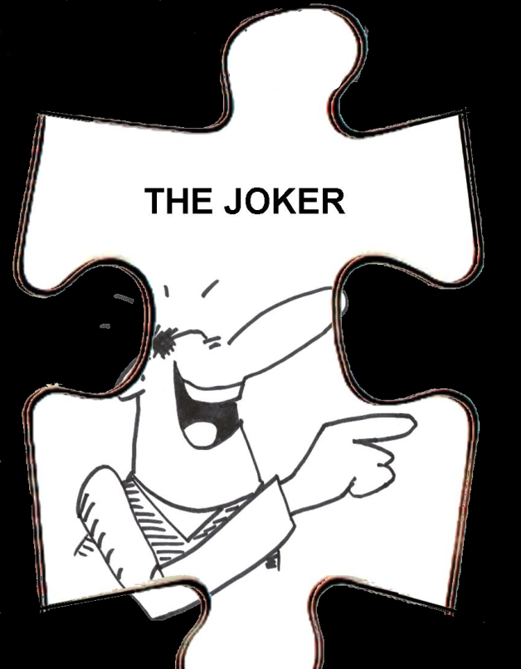

Slide 19
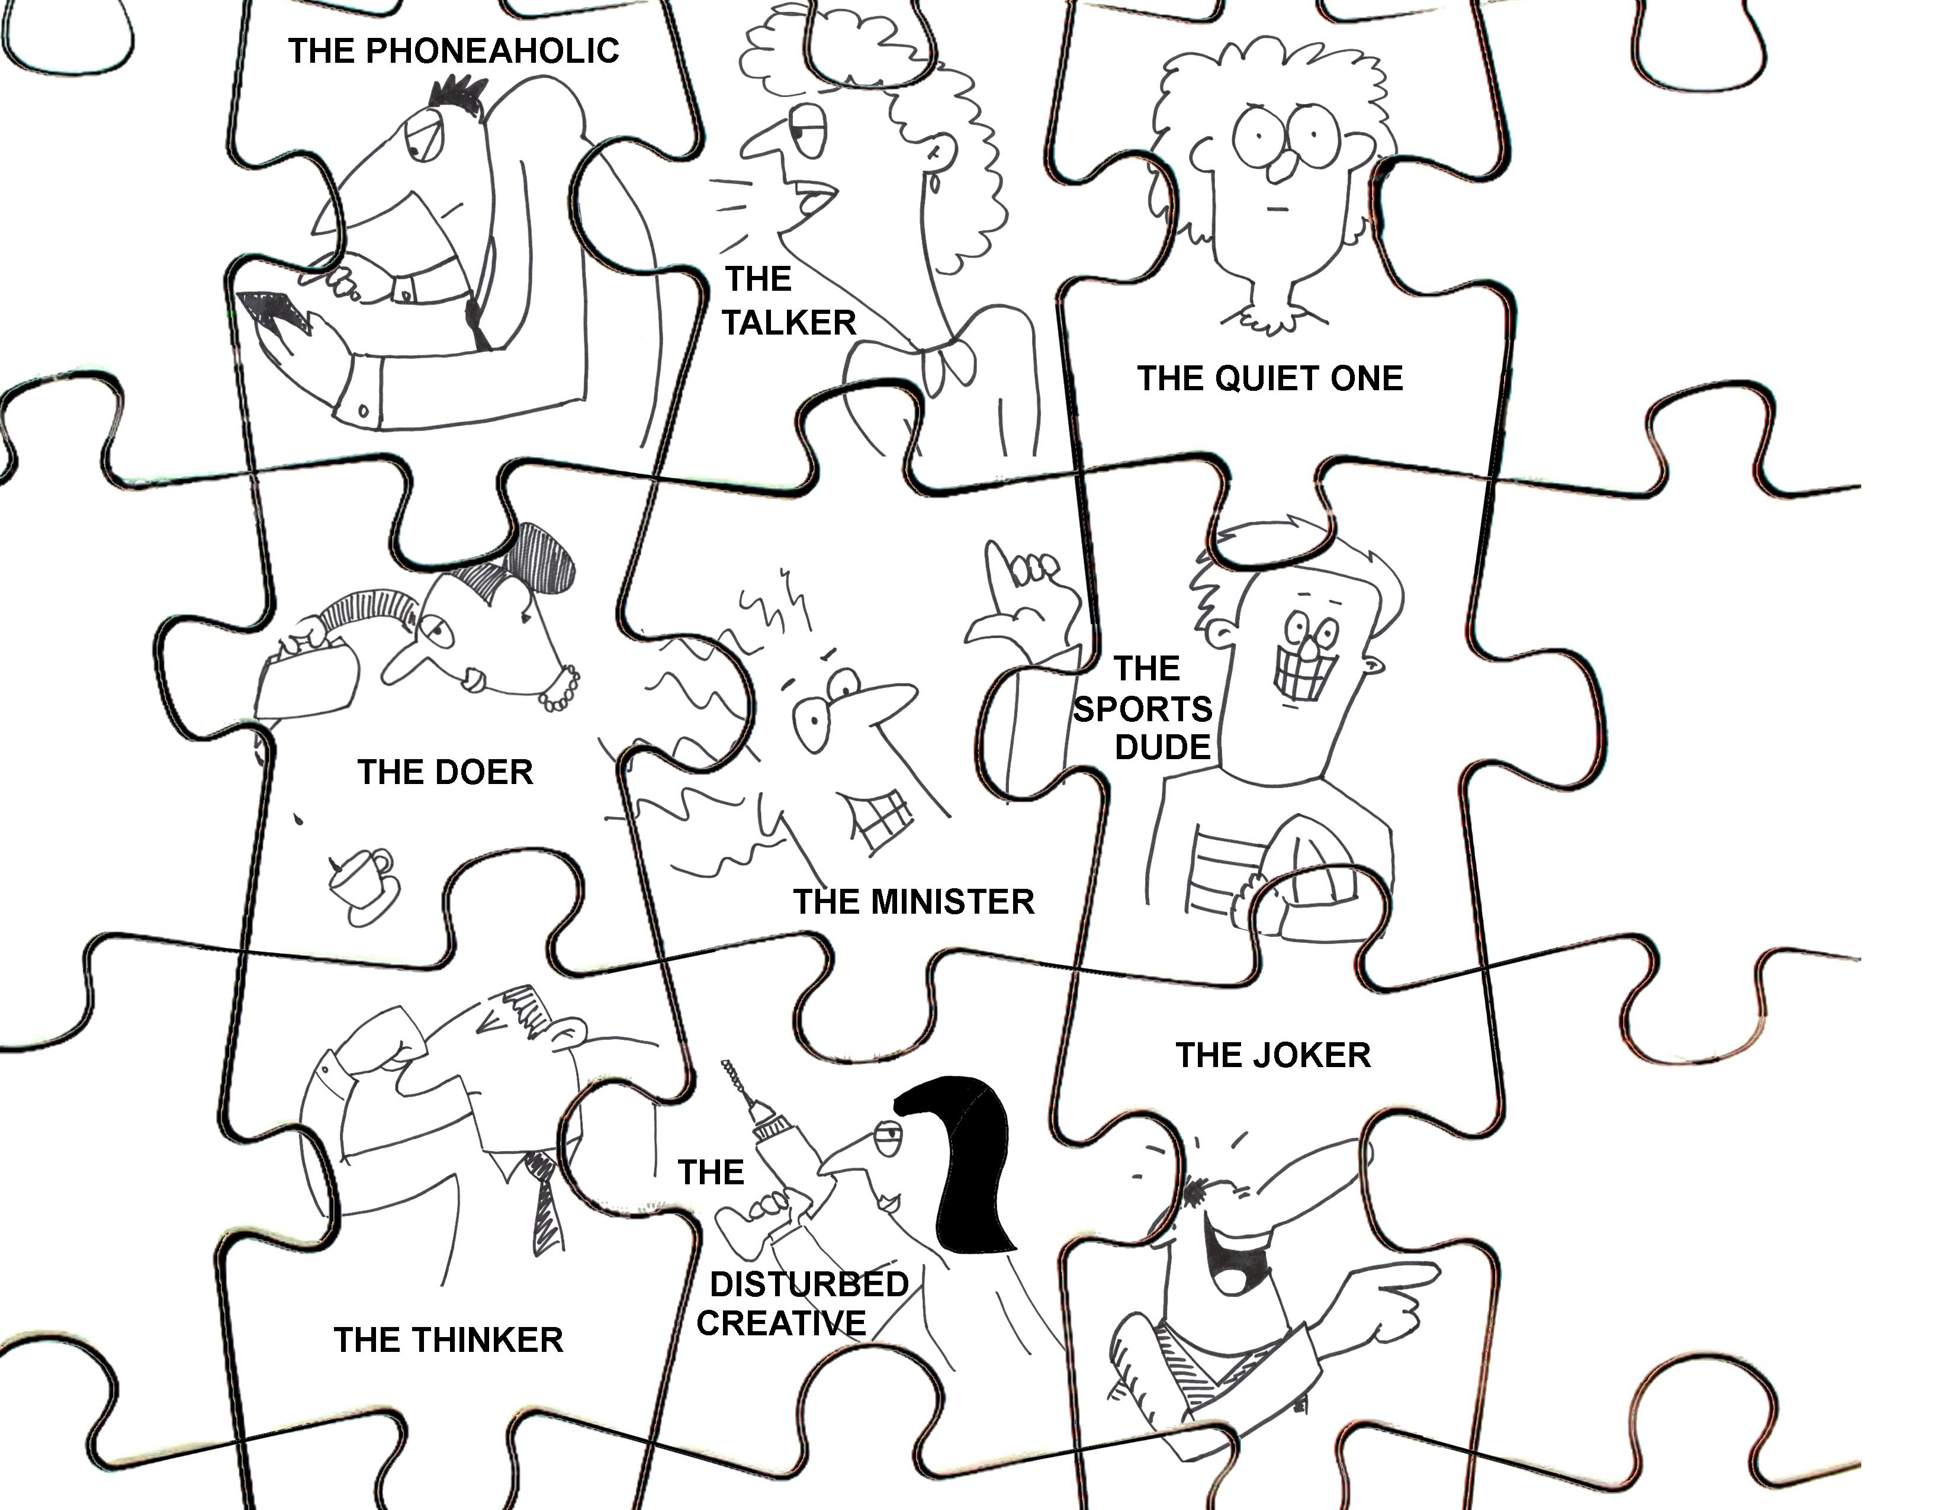

Slide 20
