Slide 1
Reduce distractions
focus on Jesus

Slide 2
Social-media

Slide 3
Smartphones

Slide 4
Television

Slide 7
We have become afraid of not doing, and we avoid it by distracting ourselves…
– Bertrand Russell

Slide 8
Worship

Slide 10
Humans beings cannot live on social media feed alone.

Slide 11
The Word

Slide 12
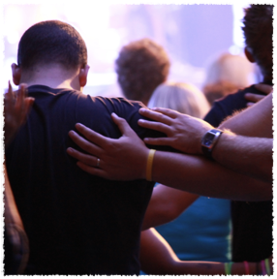
Pray

Slide 13
Reduce distractions
focus on Jesus

