Slide 1
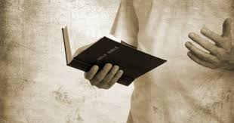
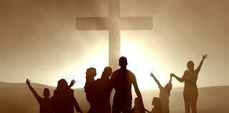
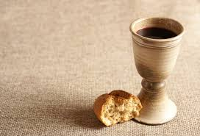
WHO ARE WE?

Slide 3
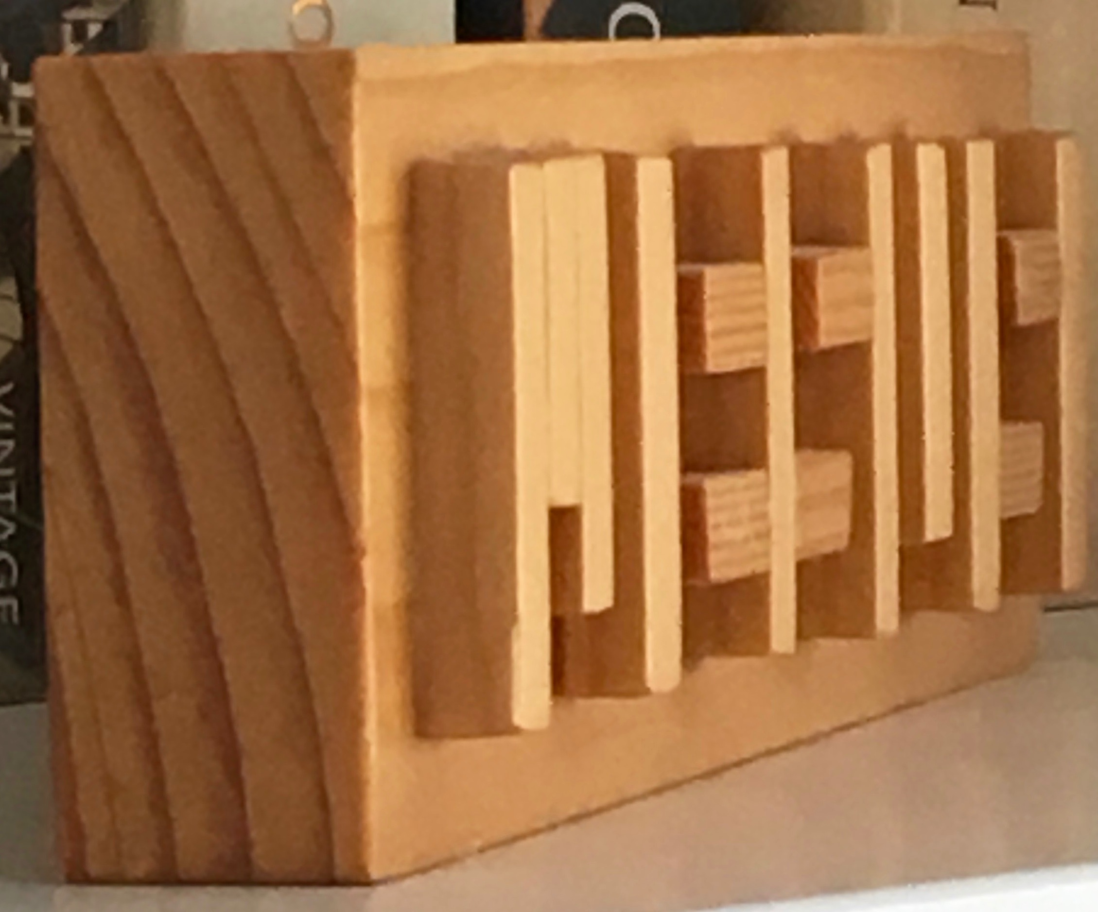

Slide 4
The Vicarious Christian

Slide 5
?
vicarious definition: experienced as a result of watching, listening to, or reading about the activities of other people, rather than by doing the activities yourself:

Slide 6
The Nostalgic Christian

Slide 7
?
nostalgia definition: is an affectionate feeling you have for the past, especially for a particularly happy time.

Slide 8
The Intentional Christian

Slide 9
?
intentional definition: done on purpose or by design or planned. A decision taken, acting intentionally.

Slide 10
Mission Centred Church

Slide 11
Mission Centred Church

Slide 12
Mission Centred Church

Slide 13
Mission Centred Church

Slide 14
Mission Centred Church
NOT just SUNDAYS but a DAILY pursuit!

