Slide 1
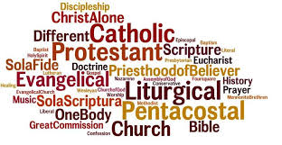
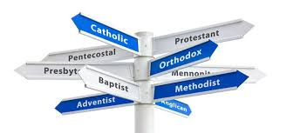
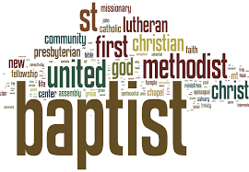

Slide 2
prosopolempsia

Slide 3
Lord of ALL
Judge of ALL
Saviour of ALL

Slide 4
Jesus is for ALL!
Are you ALL for Jesus and ALL of Jesus?

