Slide 1
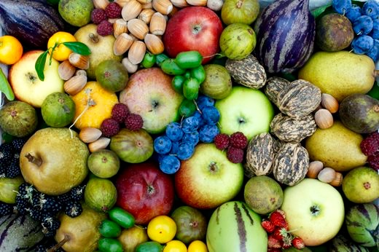
Dollingstown
HARVEST 2018

Slide 2
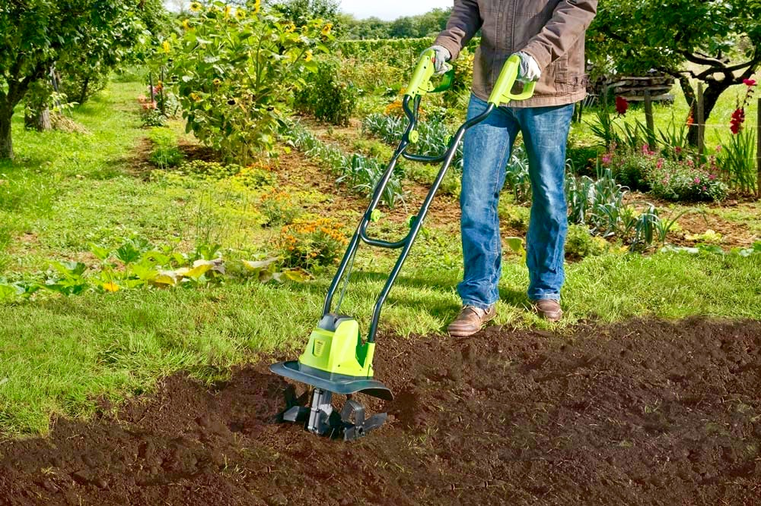

Slide 3
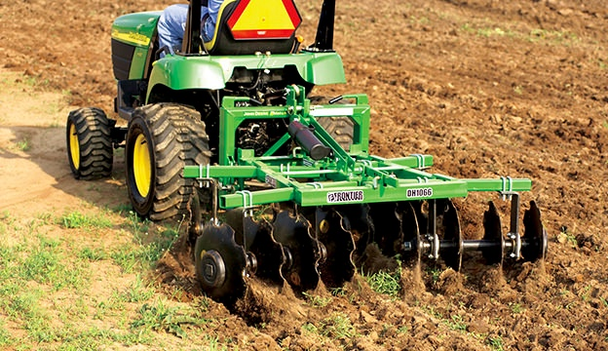

Slide 6
Background of Psalm 126
Psalm 126 does not mention a writer, some scholars believe it was written by Ezra on the occasion of the release of the Jews from the Babylonian captivity (70 year captivity). If this is so - Cyrus, king of Persia, defeated the Babylonians in 539 B.C. and granted the Jews permission to return to Judah and to rebuild the Temple in Jerusalem.

Slide 7
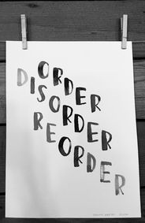
This short Psalm speaks about pilgrims / travellers / disciples / movement.
It gives a sense of perspective.
It is immersed in hope.
It reminds us that we are part of something bigger - God’s evolving story.

Slide 8
Most of us fall for the lie that God loves us if and when we change.
The truth is that God loves us so that we can change.

Slide 9


Slide 10
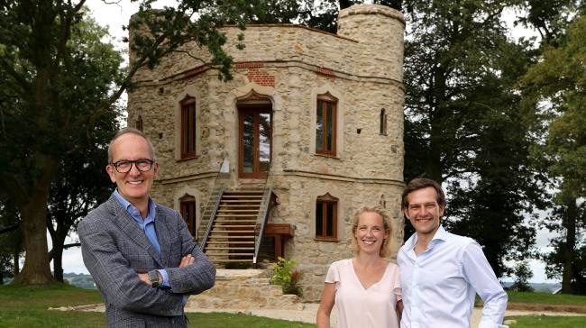

Slide 11
Transformation
Transformation has little to do with intelligence, willpower, or perfection. It has everything to do with honesty, humility, willingness, and surrender.

Slide 12
Distracted
For many of us the great danger is not that we will renounce our faith. It is that we will become so distracted and preoccupied that we will settle for a middle of the road version of it.

Slide 13
Fully - Present
The desperate need today is not for a greater number of intelligent people, or gifted people, but for people who understand the value of being fully present.

Slide 14
Grace
Our lives are full of brokenness - broken relationships, broken promises and broken expectations. How can we live with that brokenness without becoming bitter and resentful except by returning again and again to God's story. To be alive is to be broken; to be broken is to stand in need of God’s grace.

Slide 15
Obedience
Obedience means listening to and really hearing how much God loves us. Obedience means, slowly allowing God to draw us to places of restoration - some of which we might rather avoid.

Slide 16
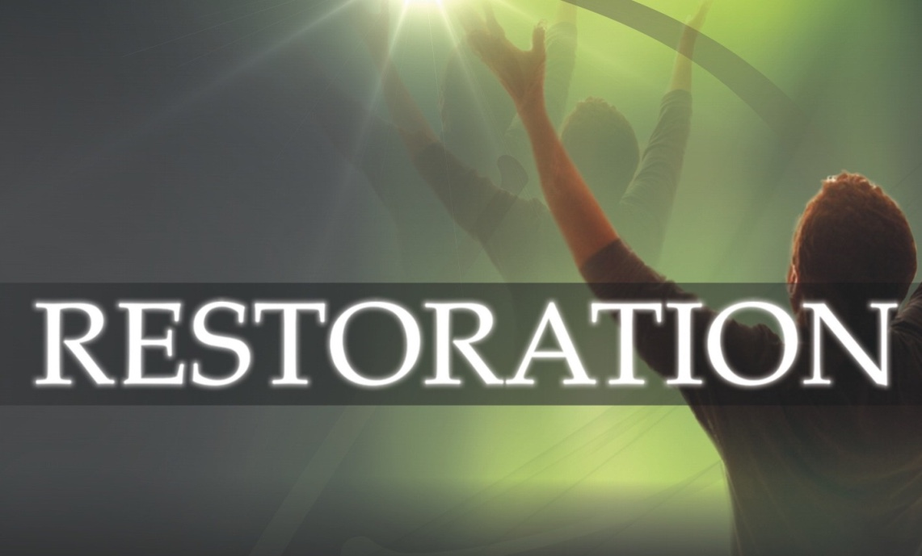
When a Moment becomes a Movement

