Slide 1
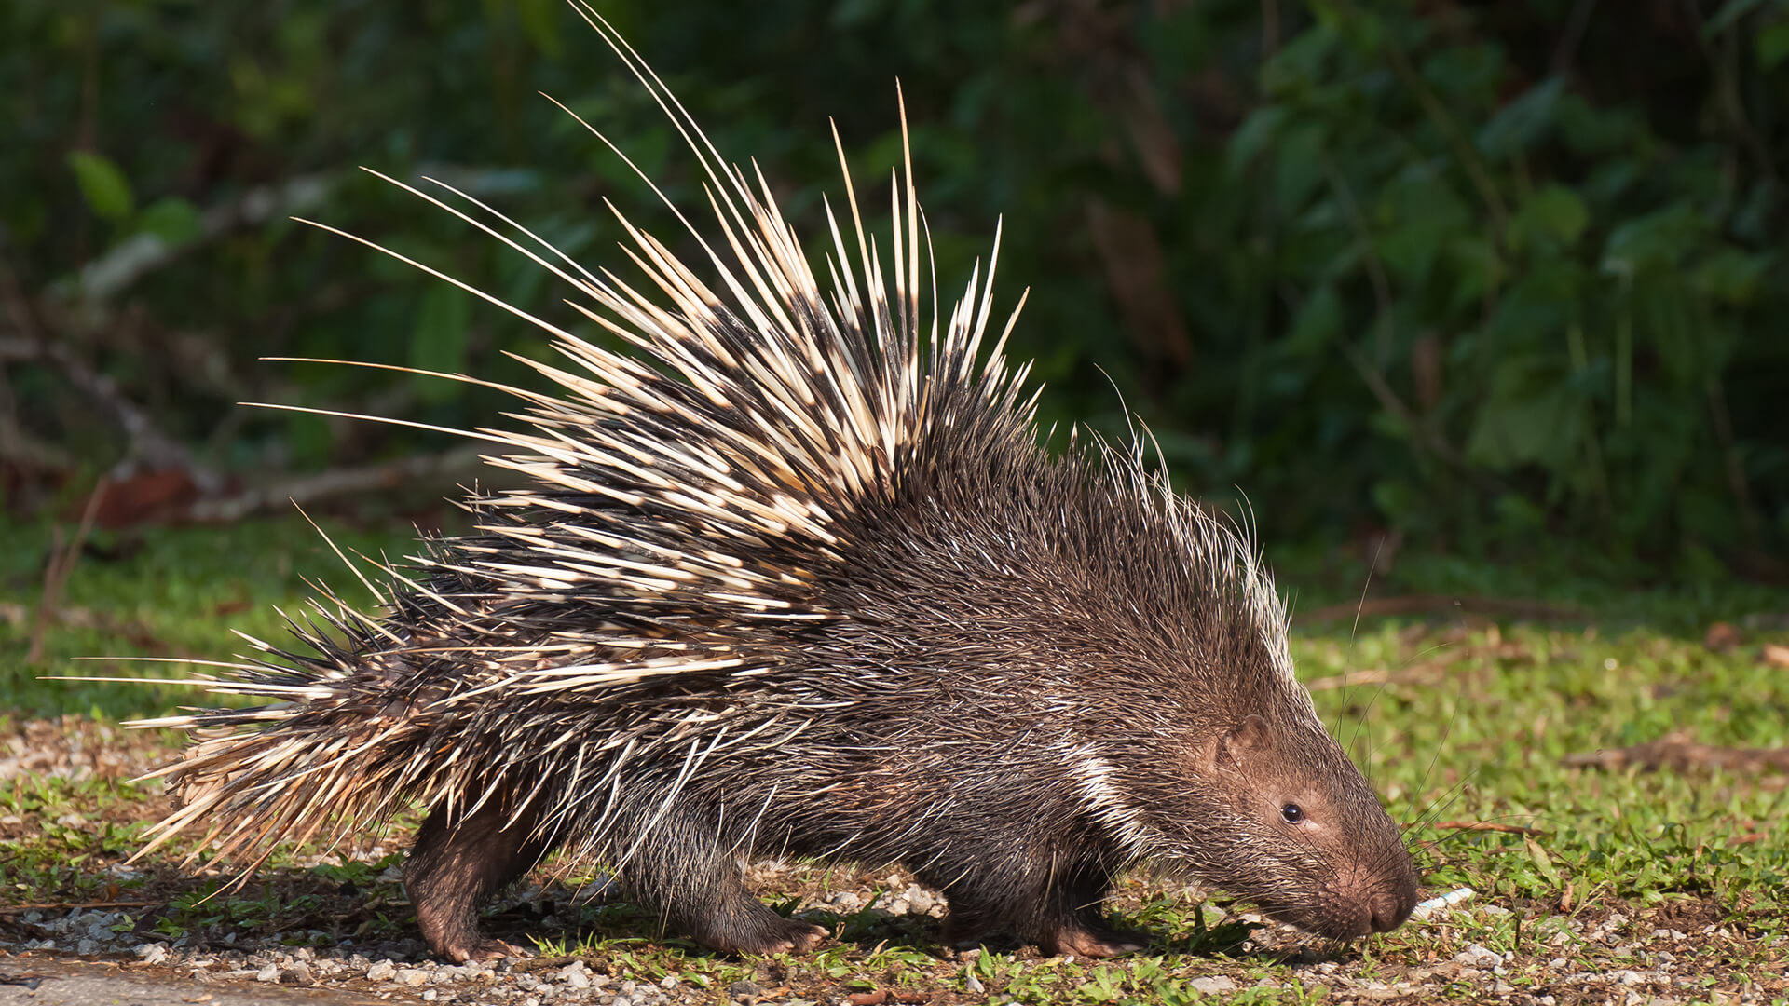
Don’t get too close!

Slide 2
MEETING

Slide 3
IMAGINE

Slide 4
KOINONIA
This is the fellowship: from the Greek word, koinos – what we have in common

Slide 5
- With whom are we in fellowship?
- What do we have in common?

Slide 6
1 John 1:3 that which we have seen and heard we proclaim also to you, so that you too may have fellowship with us; and indeed our fellowship is with the Father and with his Son Jesus Christ.
2 Corinthians 13:14 The grace of the Lord Jesus Christ and the love of God and the fellowship of the Holy Spirit be with you all.

Slide 7
SO...
Fellowship is Trinitarian! In meeting together we are in fellowship with FATHER, SON and HOLY SPIRIT

Slide 8
What draws us together?
LOVE (agape)

Slide 9
Amen and Alleluia
A tale of two soldiers

Slide 10
So what?

Slide 11
The Porcupine Syndrome
Chuck Swindoll

Slide 12
KOINONIKOS
- generous
- participation
- involvement

Slide 13
Result?

